Slide 1
Oracle Database Multitenant/Multimodel/InMemory/ACO
Workshop
José Vázquez
Andrés Araujo
Dani Villaverde
Belén Hernández
Francisco Alvarez
Stephane Duprat
9, 10 y 11 de febrero de 2021

Slide 2
Safe harbor statement
The following is intended to outline our general product direction. It is intended for information purposes only, and may not be incorporated into any contract. It is not a commitment to deliver any material, code, or functionality, and should not be relied upon in making purchasing decisions.
The development, release, timing, and pricing of any features or functionality described for Oracle’s products may change and remains at the sole discretion of Oracle Corporation.

Slide 3
Overview
MultiTenant
JSON
InMemory
ACO

Slide 4
Overview
MultiTenant
JSON
InMemory
ACO

Slide 5






Comparing Database Consolidation Architectures
Agility
Virtual Machines
Multitenant
Stacked Databases
Schema/Row Consolidation
Efficiency
Notes:
[*Be careful not to use the term “Magic Quadrant” in this slide because this is a trademark of Gartner.]
There’s an important class of ISV that we might characterize as “demoralized Y2k-era on-prem application vendors”.
Without Multitenant, as these ISVs migrate to a modern Cloud model, they are faced with two bad options.
[Click]
Either they can move to a hosted model,
[Click]
running each tenant standalone in a VM in some first-generation Cloud environment.
That might deliver some improved isolation and agility, but it’s not at all efficient.
Or, they could re-architect their application to retrofit multitenancy, which will typically involve very dramatic re-engineering
and testing efforts and lots of unsatisfactory compromises of performance, isolation and functionality.
[Click]
More modern, “cloud-born” applications typically employ a model sometimes described as “row-based consolidation”.
Essentially this model hosts multiple tenants in a single database, with each tenant’s data distinguished by a column (such as Tenant_ID) in each table, designating to whom each row belongs. With data for all tenants intermingled in the same tables it is thus up to the application to segregate the data.
For example, if a particular tenant were to consult an Orders web page, the “show me my orders” query would be satisfied by the application code constructing a SQL statement similar to
select * from orders where Tenant_ID = :Tenant_ID;
This works well up to a point, delivering great economies of scale but presents significant challenges in terms of both isolation and agility.
[Click]
Multitenant delivers great advantages to vendors in both categories.
The formerly standalone applications get instant cloud economies of scale, with no application changes and without compromising on isolation and agility
For applications born in the Cloud, we deliver the isolation and agility they have sacrificed to reduce costs, without compromising on economies of scale.

Slide 6

Classical Oracle Database Architecture
Requires memory, processes and database files
System Resources
GL
OE
AP
Notes:
Let's think about our traditional Oracle Database architecture. Every time we create a database, be it a production database, a development or a test database, what do we do? We create a set of files, we allocate a bunch of memory for managing the data, and we kick off a series of background processes.
[click]
And this is replicated for every one of the databases that we create.
As more and more databases are fired up, these replicated overheads quickly consume the available server resources and this limits the number of applications we can run on any given server.
You can see how quickly we red-line the little resource meter here.

Slide 7

Multitenant Architecture
Memory and processes required at container level only
System Resources
GL
OE
AP
GL
OE
AP
Notes:
With Oracle Database 12c, we have a new multitenant architecture, featuring pluggable databases.
We can now create a single multitenant container database.
Into this we can plug multiple pluggable databases.

Slide 8
Multitenant Architecture
More efficient utilization of system resources
System Resources
GL
OE
AP
Notes:
Now, the beauty of this new architecture is we don't need to make changes to our existing applications.
More importantly, we now only allocate one chunk of memory and one set of background processes for that container database.
So that's going to give us much greater utilization out of our existing IT resources. We’ll be able to host many more applications per database server.
So it's going to give us much greater scalability as we consolidate multiple pluggable databases into our new multitenant container database.

Slide 9
Multitenant Architecture
Components of a Multitenant Container Database (CDB)
Up to 4k PDBs per CDB
PDBs
CDB
Root
Pluggable Databases
Multitenant Container Database
Notes:
Let’s look at the components of a multitenant container database
We have the pluggable databases or PDBs
There are two parts to the term pluggable databases;
There’s “pluggable”, which is new and “databases” which is familiar.
Before we get to the revolutionary new stuff let’s discuss what hasn’t changed.
A pluggable database is a fully functional self-contained Oracle database. It’s not watered down in any way.
From the perspective of an application or an end user it hasn’t changed at all.
This is very important because it means that no application changes are required to adopt this new architecture.
[click]
We introduce a new concept: a root database
…Into which are plugged various PDBs
…And the combination is referred to as a multitenant container database.
[click]
That’s quite a mouthful, we we’ll abbreviate that as CDB.
The pluggable databases are PDBs
And Root is Root.
From an application’s point of view, it’s the PDB that’s the database.
From the operations point of view, it’s the CDB that’s the database.
[click]
…and we can currently support up to 252 PDBs per CDB – quite a lot!

Slide 10


Manage Many Databases as One
Backup databases as one; recover at pluggable database Level
GL
OE
AP
One Backup
Point-in-time recovery at pluggable database level
Notes:
In describing the efficiencies of the architecture, the sharing of background processes and the SGA, we have explained how Multitenant can help reduce capital expenditure, by consolidating more applications per server.
At this stage, we transition to focus on the second major benefit of Multitenant.
That is that we can reduce operating expenditure because of the ability to manage many databases as one.
Great data point: multiple total cost of ownership (TCO) studies conducted by IDC have found that over 60% of the average cost of running a database over any given 5 year period is represented by staff cost
A great example of managing many database as one, is backup.
Remember that from an operations point of view, it’s the CDB that’s the database.
Backup is an operational concept and therefore it follows that it applies at the level of the CDB.
[click]
We configure one backup at the level of the CDB and all PDBs are backed up as one.
However, we retain the ability to perform point-in-time recovery (PITR) at the level of the individual PDB.
So, better stated, this benefit is
“Manage many databases as one, but retain granular control where appropriate.”

Slide 11

Manage Many Databases as One with Multitenant
One standby database covers all pluggable databases
GL
OE
AP
GL
OE
AP
Primary Container Database
Standby Container Database
Notes:
Another example of managing many databases as one is the configuration of (active) data guard in a high-availability (HA) configuration.
Again, HA configuration is an operational concept, and so we configure ADG at the CDB level.
We have a single set of background processes,
including a single log writer writing a single, consolidated redo stream.
Transactions for all the PDBs in the production CDB are written to this single redo stream.
This consolidated redo stream is replicated to the standby CDB.
[click]
Plug in a new PDB into the production CDB…
And you have a corresponding PDB in the standby
Transactions in the new PDB are replicated to the standby automatically,
just by virtue of plugging that PDB into the CDB in this Active Data Guard environment.

Slide 12
Simplified Patching and Upgrades
Apply changes once, all pluggable databases updated
GL
OE
AP
12c
19c
19c
12c
12c
19c
In-place
Notes:
Another example of managing many as one with Oracle Multitenant is upgrading or patching.
Patches and upgrades are applied at the multitenant container database level.
[click]
All PDBs in that CDB are automatically upgraded in one fell swoop.
You may have noted a contradiction here.
Previously, when describing schema consolidation – a consolidation strategy that was quite successful in prior releases of Oracle Database – I mentioned that one of the downsides was that the flip-side to the advantage of being able to manage many databases as one was that you had no choice:
All databases, for example, had to be updated together, like it or not.
The “leading edge” databases had to wait for the majority to be ready.
The laggards, who, perhaps, have dependencies on third-party applications not yet certified with a new patch level, either hold the others back or are forced to upgrade before being fully certified.
What has just been described in this slide is no different…
[click for next slide]

Slide 13
Simplified Patching and Upgrades
Flexible choice when patching & upgrading databases
GL
OE
AP
GL
OE
Original Container Database 19.3
Upgraded Container Database 19.4
Notes:
But if you want the granularity of a per-PDB upgrade, it can be done by unplug/plug into a second CDB, upgraded to the required level.
So applications can be upgraded as and when they’re ready.
[click]
In this example, GL never moves to 19.4.
So, along with the advantages of managing many as one,
we’re beginning to see examples of the agility afforded by the new multitenant architecture.
With other consolidation strategies there’s typically been a trade-off between managing many as one and agility.
With Multitenant, there is no such trade-off. We can reduce operating expenses by managing many as one, and increase agility at the same time.
…and here we transition to this third major benefit of Multitenant…
[click for next slide]

Slide 14
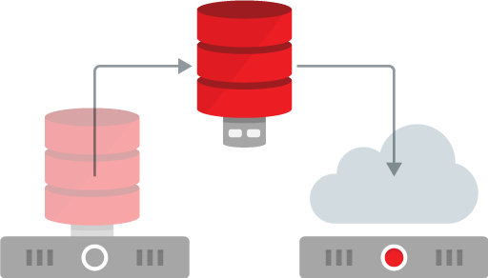


Multitenant
New in 12.2, 18c, 19c
12.2
Online cloning & relocation
Incremental refresh of test/dev master
Application containers
18c
Transportable backups
Snapshot carousel
Refreshable PDB switchover
19c
RAT and ADDM at PDB level
Container managed database virtualization
Manage Many as one
Patching, Backup, Security, Online Cloning, Online Relocation
Software as Service
Shared metadata, Data location transparency
Notes:
Automatic Database Diagnostic Monitor (ADDM) Support for Pluggable Databases (PDBs)
You can now use ADDM analysis for PDBs in a multitenant environment.
ADDM analysis at a PDB level enables you to tune a PDB effectively for better performance.

Slide 15

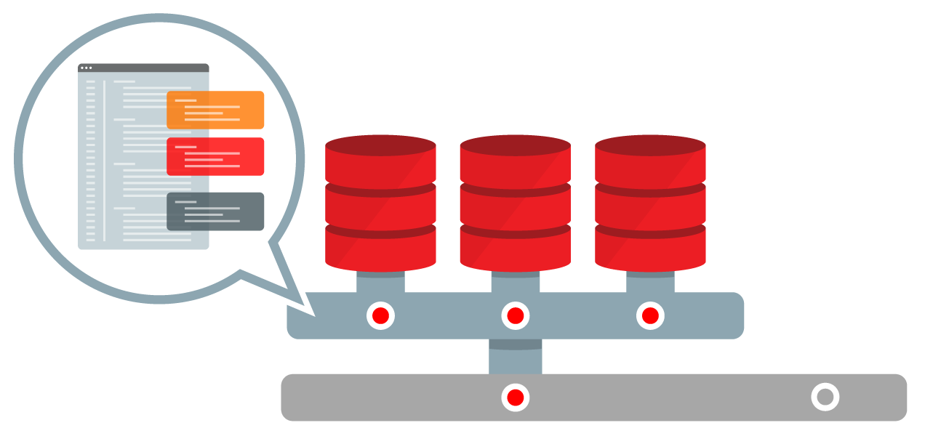

Application Container
Application Container comprises
Application Root (Master)
Application PDBs (for each Tenant)
Application Seed (for provisioning)
PDBs share application objects
Code, metadata and data
Further simplifies management
Apply updates to application container
Sync tenant PDBs from central master
Suitable for all applications
SaaS, franchise, divisional, etc.
Notes:
In 12.2, we have some fantastic new functionality in the area of SaaS.
As previously discussed, in release 12.1 Multitenant delivered an instant SaaS architecture for previously on prem applications.
This is great because each tenant is isolated within a self-contained PDB
But many such tenants can be supported in a singe CDB, delivering all the benefits of consolidation with Multitenant.
=======================================================================================================
No need to restate benefits if you include the standard benefits slide.
=======================================================================================================
Reduced CapEx because you can consolidate more tenants per server
Reduced OpEx because you can manage many tenants as one
Increased agility, through ease of provisioning, tenant migration, etc.
And it’s easy to adopt because applications run unchanged.
=======================================================================================================
No need to restate benefits if you include the standard benefits slide.
=======================================================================================================
What happens, though, when a new version of an application comes along?
We have to upgrade the application definition in each tenant PDB.
There are tools to help automate this, but it’s still a rather cumbersome process.
What we wanted to do is to extend this benefit of “manage many as one” from the DBA to the application administrator.
For this, we introduce a new concept – Application container.
[Click]
An application container is made up of:
An application root. This is the repository for the master application definition.
There are application PDBs for each tenant
And an application seed, for provisioning new tenants.
Now the application is defined once only in a central location – application root. Think of this as a master application definition.
The various tenant PDBs or application PDBs share application objects – such as code, metadata and data – from the application root.
We can create an application seed, from which new tenant PDBs can simply be created.
Now, when a new version of the application is available, we upgrade this central master application definition in Application root.
It’s then a simple process to sync the various tenants with this new master definition.
Now, before you think, “that’s cool, but it’s not for me”, think again.
For one thing, the use of SaaS type applications extends beyond classic SaaS vendors.
Good examples include franchises, such as fast food restaurants, cafes, fro-yo shops.
=======================================================================================================
Lengthier text.
=======================================================================================================
Other examples are things like car dealerships. Anywhere you have a common operating model but independent franchisees lends itself very well to Application Container.
Application container allows you to share common meta data and data.
Many application architectures include a common module, whose definition and/or common data can be shared in this way.

Slide 16
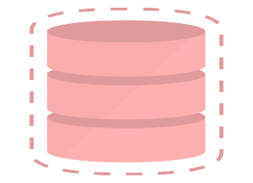
Multitenant for Provisioning
Fast cloning of PDBs
PDBs can be cloned from within the same CDB
GL-1
GL-2
AP-1
AP-2
PO-1
PDBs can be cloned from remote CDBs
GL
OE
AP
PO
PDBs can be cloned from non-CDBs
Thinly provision snapshot clones in seconds
Notes:
The need to provision databases is a constant challenge for DBAs.
In Oracle Multitenant, we greatly simplify the process of database provisioning via cloning of existing databases.
[click]-
[click]-
[click]-
[click]-
And read slide as you go.

Slide 17







PDB Hot Clone
Snap Clone
Snap Clone
PDB Hot Clone
Online test master instantiation
Oracle Cloud
CRM
CRM Dev1
CRM Dev2
Hot Clone
Developers
Pricing
Retail
CRM
On-Premises
Notes:
What’s illustrated here is a typical lifecycle management (or LCM) situation
In a hybrid cloud configuration.
There are three production PDBs running in a highly efficient consolidated environment on premises.
Development and testing has shifted to the cloud.
The requirement is to set up a golden master database in the cloud
From which members of the development team can provision their own isolated environments.
Let’s consider the requirements in turn.
The fundamental capability here is online cloning, also known as hot cloning.
[click]
From the perspective of this video series – high availability –
The key thing is to set up the golden master without taking an outage in production.
This is why it is so important to be able to do a hot clone –
taken while the source PDB is still open read-write.
No application outage is required for a hot clone –
[click]
Individual developers can provision their own snapshot clones from this golden master.
Based on copy-on-write technology, these are highly storage-efficient;
They require negligible incremental storage and can therefore be provisioned very rapidly.
Here the high availability angle is the ability to create – and destroy and re-create –
individual development environments very rapidly without impacting other developers.

Slide 18

Refreshable PDB
Snap Clone
Snap Clone
PDB Hot Clone
Online test master instantiation
Refreshable PDB
Incremental refresh of clone with latest data
Oracle Cloud
CRM
CRM Dev1
CRM Dev2
Cloned version no longer in sync
Only changes copied and applied
Developers
Pricing
Retail
CRM
Changes made to database
TIME
On-Premises
Notes:
Refreshable PDB builds upon Hot Clone.
Let’s continue our discussion of the development and testing use case in which one of the development Golden Master databases is a clone of production.
Production databases tend to be large. The larger they are, the longer they take to copy.
If your production database is in the tens of terabytes scale, it will take in the order of days to copy it.
You don’t want to do that sort of thing very often, and therefore development copies of this sort of production database tend to be rather stale.
The staler the database, the less relevant it is for development purposes, such as debugging.
That’s why we built Refreshable PDB.
[Click]
Step 1 is to take a hot clone. That takes as long as it takes. Hours, days, whatever. It doesn’t really matter since this does not involve an outage in production.
[Click]
Now, as the clone becomes stale, we can refresh it.
We do this by applying all the transactions that have accumulated since the last refresh.
Even if the source database is enormous, this incremental set will typically be much smaller.
It’s therefore going to be a much, much quicker process than the initial hot clone.
Therefore it’s going to be much simpler to keep your production clones refreshed with recent data copied from production.
The clone may be refreshed either manually or on a specific schedule, perhaps every 24 hours.
The relevance of this capability from the perspective of high availability
Is the availability of freshly-updated data from production in the development master –
an invaluable capability for rapidly debugging data-specific bugs.

Slide 19


Online PDB Relocation
PDB Hot Clone
Online test master instantiation
Refreshable PDB
Incremental refresh of clone with latest data
Online PDB Relocation
Relocate with no downtime
CRM
HR
Oracle Cloud
Pricing
Retail
CRM
On-Premises
Notes:
Now we shift gears back into Production, to discuss Online PDB relocation.
Why do you want this?
You want this because we want this.
We needed this capability for Oracle Cloud Database Services, including Autonomous Database.
I’ll tell you why.
Service Level Agreements (SLAs) typically feature two conflicting aspects – performance and availability.
If a database is in danger of violating its performance SLA,
the solution is typically to move it to a server with more available processing power.
However, to do so traditionally involves an outage in the application,
and this is likely to violate the availability component of the SLA.
So the high availability requirement is to be able to relocate a PDB between servers without taking an outage.
This is possible with Online PDB Relocation.
Under the covers, we create a refreshable clone,
Top it up with the latest changes
And transparently switch connections.
When that’s complete the original PDB is dropped.
It’s all accomplished with a single SQL statement.

Slide 20



Advantages of Multitenant Architecture
Isolation and agility with economies of scale
AP
Self-contained PDB for each application
Applications run unchanged
Rapid provisioning (via clones)
Portability (via pluggability)
GL
OE
Common operations performed at CDB level
Manage many as one (upgrade, HA, backup)
Granular control when appropriate
Shared memory and background processes
More applications per server
Complementary to VMs
Notes:
Brief Version
Oracle Multitenant delivers the full promise of the Database Cloud:
Isolation and Agility with Economies of Scale.
Applications run unchanged in self-contained Pluggable Databases or PDBs.
PDBs are simple to clone and to move to and around the Cloud.
A container database or CDB consolidates many PDBs.
Patch the CDB and fix all the PDBs it contains in a single stroke!
That’s operational efficiency!
The shared infrastructure model is highly efficient so you can support more applications per server.
That’s technical efficiency!
Longer Version
This slide summarizes Oracle Multitenant -- the container database architecture -- the first database designed for the Cloud.
[click]
We have these self-contained “pluggable databases” or PDBs for each application or tenant.
From the point of view of an application, the PDB is the database,
In which applications run unchanged.
PDBs can be very rapidly provisioned
And a pluggable database is a portable database,
which makes it very easy to move around, perhaps for load balancing or migration to the Cloud
[click]
Many PDBs can be plugged into a single Multitenant Container Database or CDB.
From the point of view of a DBA, the CDB is the database –
Common operations are performed at the level of the CDB
Enabling the DBA to manage many as one,
for operations such as upgrade, configuration of high availability, taking backups.
But we retain granular control when appropriate.
This ability to manage many as one enables tremendous gains in operational efficiency.
[click]
Enormous gains in technical efficiency are enabled by a shared technical infrastructure.
There’s a single set of background processes
And a single, global memory area – the SGA – shared by all the PDBs.
The result is that with this architecture we can consolidate more applications per server.
These huge gains in operational and technical efficiency deliver the economies of scale promised by the Cloud.
Let’s review the other critical components, starting with isolation.

Slide 21
Overview
MultiTenant
JSON
InMemory
ACO

Slide 22

What is JSON?
JSON stands for JavaScript Object Notation
It’s a "lightweight", readable data interchange format that’s language independent
Most popular data format for new web applications
Instead of creating an entity relationship model to define all of the data the application needs and then mapping it to a set of relational tables
Storing JSON documents in the database greatly simplifies application development as the same schema-less data representation can be use in Application and the Database

Slide 23
What is JSON?
{"id":1,
"name":"Century 16",
"location":{"street":"Main St",
"city":"Redwood",
"zipCode":"94607",
"state":"CA",
"phoneNumber":null
}, "ticketPrice":{"adultPrice":14.95, "childPrice":9.95, "seniorPrice":9.95
}
}
A data format that consists of one or more name value pairs enclosed in curly brackets
The name is always a string and is separated from the value by a colon
A value can be a number, string, true, false null, an object or array
E.g. location is an object as it has random set of name value pairs nested inside , enclosed in { }
An array is an ordered list of related items which could be JSON objects and is enclosed in [ ]
Each pair is separated by a comma

Slide 24
Storing JSON in the Oracle Database
Table containing JSON documents
CREATE TABLE theater
(
theater_id VARCHAR2(255),
json_document BLOB
);
Oracle stores JSON in table columns
No special data type
Can be VARCHAR2, BLOB or CLOB
JSON supported by all Oracle features
Analytics, Encryption, In-Memory, RAC, Replication, Parallel SQL, …
Plus can index any JSON element

Slide 25

Storing JSON in the Oracle Database
Table containing JSON documents
CREATE TABLE theater
(
theater_id VARCHAR2(255),
json_document BLOB
CONSTRAINT is_json CHECK (json_document IS JSON)
);
Oracle stores JSON in table columns
No special data type
Can be VARCHAR2, BLOB or CLOB
JSON supported by all Oracle features
Analytics, Encryption, In-Memory, RAC, Replication, Parallel SQL, …
Plus can index any JSON element
IS JSON check constraint enforces lax JSON syntax by default
Does not require NAME attributes to be in double quotes
{id:1,
name:"Century 16",
}
{"id":1,
"name":"Century 16",
}

Slide 26
Storing JSON in the Oracle Database
Which data type to pick?
VARCHAR2
Best performance, easy to retrieve via SELECT
Limited max size of 32k only (with MAX_STRING_SIZE=EXTENDED)
BLOB
Best LOB performance but not as fast as VARCHAR2
Unlimited size, not as easy to retrieve via SELECT
No potential characterset conversion
CLOB
Unlimited size, easy to retrieve via SELECT
Potential characterset conversion (from 1 byte UTF-8 to 2 byte USC-2, double space)
Potential bigger size on disk

Slide 27







Oracle Database as a Document Store
Flexible Schema development
JSON
Via RESTful service
SQL
JSON
Via Native APIs
Data analyzed via SQL
Data persisted in database
In JSON
Notes:
New ‘Document-Store’ API’s for application development
REST services
Document / Collection centric APIs for JAVA
Higher level frameworks for popular scripting languages
All existing RDBMS APIs can access JSON documents stored in Oracle RDBMS
Use OCI, JDBC, .NET to store and retrieve JSON Documents
Execute JSON Path expressions using SQL/JSON operators

Slide 28

JSON Support in Oracle Database
Fast Application Development + Powerful SQL Access
Application developers:
Access JSON documents using RESTful API
SQL Developers and Analytical tools:
Query JSON using SQL
PUT /my_database/my_schema/customers HTTP/1.0
Content-Type: application/json
Body:
{
"firstName": "John", “lastName”: "Smith", "age": 25, "address": { "streetAddress": "21 2nd Street", "city": "New York", "state": "NY", "postalCode": "10021“, "isBusiness" : false }, "phoneNumbers": [ {"type": "home", "number": "212 555-1234“ }, {"type": "fax", "number": "646 555-4567“ } ]
}
select
c.json_document.firstName,
c.json_document.lastName,
c.json_document.address.city
from customers c;
firstName lastName address.city
----------- ----------- --------------
“John” “Smith” “New York”
Oracle Database 12c
JSON
Notes:
TWO BUILDS
JSON documents can be stored in an Oracle database
<click>
Web/mobile developers use REST or other non-SQL api’s to build their applications
<click>
Database developers and Bi users access the same JSON documents via SQL
NoSQL databases in general do not provide SQL access, but SQL provides key benefits:
- powerful and efficient query and reporting (including integration with BI tools)
- data integration between JSON and relational data

Slide 29


Oracle REST Data Services Serving JSON results from relational data
Oracle REST Data Services
URI
Map and Bind
SQL
JSON
Transform to JSON
Transform
SQL Result Set
HTTP(S) client
Oracle Database
Data stored in standard relational tables and columns
Oracle REST Data Services (ORDS) Developer defines URI<>SQL mapping
App Developer calls named URI over HTTP(S) gets and posts
Notes:
Client goes thru app mid tier (not shown)
Data stored in standard relational tables and columns
ORDS Developer defines SQL that satisfies named URI requests
App Developer calls named URI over http(s) gets and posts
ORDS maps URI to the SQL and performs data bindings
ORDS transforms the SQL result set to JSON

Slide 30


Oracle REST Data Services
HTTP(s) API App-Dev with Relational Tables in Oracle Database
Context Root
Module
Template
HTTP(s)
URI Request or HTTP(s) post mapped to SQL request
URI
https://myhost/myapp/hr/customerorders/1001
JDBC Connection Pool
Oracle REST
Data Services
SQL
{ “custno”: 1001,
“name”: “Scott King”,
“address”: “500 Main street, Innovation CA”,
“orders”: [ { “orderno”: 404,
“orderdate”: “Feb 27, 2016”,
“status”: “in process”} } }
{ “orderno”: 303,
“orderdate”: “Feb 26, 2016”,
“status”: “in process”} ] }
SQL result to JSON transformation
JSON
Oracle Database
ORDS maps standard URI requests to corresponding relational SQL (not schemaless): e.g. SQL SELECT from customers and orders table.
ORDS also transforms the SQL results into JavaScript Object Notation (JSON), other formats include HTML, binary and CSV.
Fully committed to supporting any and all standards required by Fusion / SaaS / FMW; we are actively engaged in the ongoing dialog.
Notes:
Built in is glassfish grizzly

Slide 31




ORDS Typical Architecture
HTTP(s)
Request
Results
Standard webserver layout
Implements Java Servlet
Deploys to Tomcat or WLS
Also Supported: Standalone mode (Jetty)
Apache
Static Files
-HTML, CSS, JS
/ords/…
/db1/hr/emp/
JSON
Binary
HTML
…
ORDS
Tomcat, WLS
JDBC pool1 pool2 pool3
JDBC
JDBC

Slide 32
ORDS Standalone Deployments
HTTP(s)
Request
ORDS running as a OS process
Eclipse Jetty Webserver & Servlet Container
Supported for Production
Offers much fewer control, configuration, and management features
Static Files
-HTML, CSS, JS
Results
ORDS w/Embedded Jetty
/db1/hr/emp/
JSON
Binary
HTML
…
JDBC pool1 pool2 pool3
JDBC
JDBC

Slide 33
SODA: Simple Oracle Document Access
A simple NoSQL-style API for Oracle
Collection Management: Create and drop collections
Document Management: CRUD (Create, Retrieve, Update and Delete) operations
List and Search: (Query-by-Example) operations on collections
Utility and Control: Bulk Insert, index management
Developers can work with Oracle without learning SQL or requiring DBA support
Same development experience as pure-play document stores

Slide 34
Overview
MultiTenant
JSON
InMemory
ACO

Slide 35
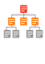

Reduced Overhead
Faster Analytics -- Less Storage Overhead
1 – 3
OLTP
Indexes
10 – 20
Analytic
Indexes
Analytic indexes can slow down the performance of transactional applications
Requires significantly more database storage (on costly tier 1 storage)
Increases overhead due to index maintenance
Database In-Memory allows users to eliminate analytic reporting indexes – without impacting performance
Removing the need for analytic reporting indexes greatly simplifies tuning and reduces ongoing administration
Table
Using Database In-Memory resulted in:
Performance Gains: 1.8X to 12X
Space savings and reduced contention on DML by dropping analytic indexes
Notes:
Up until now, the only way to run analytic queries with an acceptable response on an OLTP environment was to create specific indexes for these queries.
The good thing about indexes is that they are extremely scalable. They work well in-memory & are extremely efficient on-disk since they minimize disk IO needed to find the requested data.
However, each reporting index is an additional stored structure that must be maintained and logged with every change made to the table. This additional overhead can have a huge impact on the transaction processing as the number of analytic indexes increases. The necessity to have indexes in place removes the ability to do ad-hoc analytics.
Replacing the analytic indexes with Database In-Memory, if tables fit in memory, makes DML operations faster and reduces the overall storage space required for system. And unlike a pure in-memory database, if the system should crash and need to restart the business can still operate fully. OLTP queries and updates (the heart of any transaction based system) will perform just as they always do against the indexed row store.
Analytical queries will execute slowly until the IM Column Store is populated, but they will still run.
You don’t have to wait for all of the data to be populated in memory before resuming your business.
Removing the need for analytic indexes greatly simplifies tuning and reduces ongoing administration as well as the footprint of the database on disk as the volume of redo and undo generated will be greatly reduced.

Slide 36
Row Format Databases vs. Column Format Databases
Rows Stored Contiguously
SALES
Transactions run faster on row format
Example: Query or Insert a sales order
Fast processing few rows, many columns
Query
Query
Columns Stored Contiguously
SALES
Analytics run faster on column format
Example : Report on sales totals by region
Fast accessing few columns, many rows
Query
Until Now Must Choose One Format and Suffer Tradeoffs
Notes:
Row format is optimized for OLTP workloads.
OLTP operations tend to access only a few rows but touch all of the columns. A row format allows quick access to all of the columns in a record since all the data for a given record are kept together in-memory and on-storage. Since all data for a row is kept together, much of the row data will be brought into the CPU with a single memory reference. Row format is also much more efficient for row updates and inserts.
Analytical workloads access few columns but scan the entire data set. They also typically require some sort of aggregation. A columnar format allows for much faster data retrieval when only a few columns in a table are selected because all the data for a column is kept together in-memory and a single memory access will load many column values into the CPU. It also lends itself to faster filtering and aggregation, making it the most optimzed format for analytics.
Up until now you have been force to pick just one format and suffer the tradeoff of either sub-optimal OLTP or sub-optimal Analytics.

Slide 37




Breakthrough: Dual Format Database
Buffer Cache
New In-Memory Column Store
BOTH row and column formats for same table
Simultaneously active and transactionally consistent
Analytics & reporting use new in-memory Column format
OLTP uses proven row format
SALES
SALES
Row
Format
Column
Format
SALES

Slide 38
In-Memory Area: Static Area within SGA
Contains data in the new In-Memory Columnar Format
Controlled by INMEMORY_SIZE parameter
Minimum size of 100MB
Can be re-sized larger while database is running (12.2)
SGA_TARGET must be large enough to accommodate In-Memory area
System Global Area SGA
Buffer Cache
Shared Pool
Log Buffer
In-Memory Area
Large Pool
Other
38

Slide 39
Oracle In-Memory: Simple to Implement
Configure Memory Capacity
inmemory_size = XXX GB
Configure tables or partitions to be in memory
alter table | partition … inmemory;
Later drop analytic indexes to speed up OLTP
Notes:
Implementing the In-Memory column store is as simple as flipping a switch. All you have to do is specify how much memory the column store can use,
Then decide which objects (tables, partitions, and columns) you want to be loaded into the column store and your done using Oracle’s advisor. Oracle will take care of the rest.
The Optimizer will simply direct any analytic queries to the In-Memory Column store, allowing you to do drop any indexes that were specifically created to
enable analytic query performance.

Slide 40
Overview
MultiTenant
JSON
InMemory
ACO

Slide 41
Oracle Advanced Compression Option
OLTP Table Compression
SecureFiles Deduplication
SecureFiles Compression
Data Pump Data Compression
RMAN Fast Backup Compression
Data Guard Redo Transport Compression
Relational Data Compression
Unstructured Data Compression
Backup Data Compression
Network Data Compression
Reduce requerimientos de recursos y costes
Almacenamiento
Ancho de banda
Uso de memoria

Slide 42
Oracle Advanced Compression Option
OLTP Table Compression
SecureFiles Deduplication
SecureFiles Compression
Data Pump Data Compression
RMAN Fast Backup Compression
Data Guard Redo Transport Compression
Relational Data Compression
Unstructured Data Compression
Backup Data Compression
Network Data Compression
Reduce requerimientos de recursos y costes
Almacenamiento
Ancho de banda
Uso de memoria

Slide 43
Compresión de Datos Estructurados Para aplicaciones OLTP y Data Warehousing
Introducido en Oracle9i Release 2
Compresión durante las operaciones masivas de carga (Direct Load, CTAS)
Los datos modificados mediante DML no se comprimen
Desde Oracle 11g extiende la compresión a datos OLTP
Soporte para operaciones DML convencionales (INSERT, UPDATE, DELETE)
Beneficios
Mejor rendimiento para las consultas de acceso a grandes cantidades de datos
Los datos se comprimen a nivel de bloque de base de datos
No es necesario descomprimir los datos al leerlos
Notes:
Lets first talk about compression of regular relational data. We were the early pioneer in terms of compression technology for databases when we introduced table compression for bulk load operations in Oracle9i. Using this feature, customers can compress data at the time of doing bulk load using operations such as DIRECTLOAD, CTAS, etc. However, until now, compression was not available for regular data manipulation operations such as INSERT and UPDATE. In Oracle database 11g, we have extended the compression technology to support these operations as well. Consequently, compression in Oracle Database 11g can be used for all kinds of workload – be it OLTP or DW.
It is important to mention here is that table compression enhancements introduced Oracle database 11g are not just incremental changes. Rather enormous amount of work has gone into making sure that the new compression technology has negligible impact on updates since any noticeable write time penalty due to compression won’t be acceptable in OLTP environment. As a result compression technology in Oracle database 11g is very efficient which could reduce the space consumption up to 2 to 3 times. And while you do that, not only your write performance does not degrade, your read performance or queries actually improves. This is because unlike desktop based compression techniques where you have to wait for data to uncompressed, our technology reads the compressed data directly and does not require any uncompression. This make sure that our query performance does not degrade because of compression. Now, the question is how does the query performance improve. It does so because we need to fetch less data to answer a query due to compression. Another advantage of fetching less data to satisfy a query is that we can now use the memory used to buffer the data read from disk more efficient thereby maximizing the memory utilization efficiency.
Finally, just to make sure that I do not miss any thing obvious, our compression technology is completely application transparent. That mean that you can use this technology with any home grown or packaged application such as SAP, Siebel , EBS, etc.
---------------
We pioneered compression technology when we introduced table compression for bulk load operations in Oracle9i. Using this feature, customers can compress data at the time of doing bulk load using operations such as DIRECTLOAD, CTAS, etc. However, until now, compression was not available for regular data manipulation operations such as INSERT, UPDATE and DELETES. In Oracle database 11g, we have extended the compression technology to support these operations as well. Consequently, compression in Oracle Database 11g can be used for all kinds of workload – be it OLTP or DW.

Slide 44
OLTP Proceso compresión de tabla
Bloque
vacio
Initialmente Bloque no comprimido
Bloque comprimido
Parcialmente Comprimido
Bloque Comprimido
Cabecera
Dato no comprimido
Espacio libre
Dato comprimido
Notes:
As stated above, OLTP Table Compression has no adverse impact on read operations. There is additional work performed while writing data, making it impossible to eliminate performance overhead for write operations However, Oracle has put in a significant amount of work to minimize this overhead for OLTP Table Compression. Oracle compresses blocks in batch mode rather than compressing data every time a write operation takes place.
A newly initialized block remains uncompressed until data in the block reaches an internally controlled threshold. When a transaction causes the data in the block to reach this threshold, all contents of the block are compressed. Subsequently, as more data is added to the block and the threshold is again reached, the entire block is recompressed to achieve the highest level of compression. This process repeats until Oracle determines that the block can no longer benefit from further compression. Only transactions that trigger the compression of the block will experience the slight compression overhead. Therefore, a majority of OLTP transactions on compressed blocks will have the exact same performance as they would with uncompressed blocks

Slide 45
OLTP Compresión Tabla
Initially Uncompressed Block
Employee Table
ID
FIRST_NAME
LAST_NAME
Header
1
John
Doe
1•John•Doe 2•Jane• Doe 3•John•Smith 4• Jane • Doe
Free Space
2
Jane
Doe
3
John
Smith
4
Jane
Doe
INSERT INTO EMPLOYEE
VALUES (5, ‘Jack’, ‘Smith’);
COMMIT;
Notes:
Oracle’s OLTP Table Compression uses a unique compression algorithm specifically designed to work with OLTP applications.
The algorithm works by eliminating duplicate values within a database block, even across multiple. Compressed blocks contain a structure called a symbol table that maintains compression metadata columns. When a block is compressed, duplicate values are eliminated by first adding a single copy of the duplicate value to the symbol table Each duplicate value is then replaced by a short reference to the appropriate entry in the symbol table. Through this innovative design, compressed data is self-contained within the database block as the metadata used to translate compressed data into its original state is stored in the block.

Slide 46
OLTP Compresión Tabla
Employee Table
Compressed Block
Block
Header
ID
FIRST_NAME
LAST_NAME
1
John
Doe
John=|Doe=|Jane=|Smith=
1•• 2•• 3•• 4 •  •  5•Jack•
1•John•Doe 2•Jane• Doe 3•John•Smith 4• Jane • Doe
Free Space
2
Jane
Doe
3
John
Smith
4
Jane
Doe
5
Jack
Smith
Local
Symbol Table
Notes:
Start with a table ‘Employee’ that has compression enabled and we can see a block containing this data.
In the beginning the block is not compressed because it is NOT full
Then we issue an insert statement which triggers the block to compress…
We create the Symbol Table (or dictionary) in the block header for data that has duplicate values (i.e. ‘John’,’Doe’,and ‘Jane’)
Then we replace the data in the block with the relevant symbol

Slide 47
OLTP Table Compression
Uncompressed Block
Compressed Block
Header
Header
John=|Doe=|Jane=|Smith=
1•• 2•• 3•• 4 •  •  5•Jack•
Free Space
1•John•Doe 2•Jane• Doe 3•John•Smith 4• Jane • Doe 5•Jack •Smith Free Space
1•John•Doe 2•Jane• Doe 3•John•Smith 4• Jane • Doe
Local
Symbol Table
More Data
Per Block
Notes:
Start with a table ‘Employee’ that has compression enabled and we can see a block containing this data.
In the beginning the block is not compressed because it is NOT full
Then we issue an insert statement which triggers the block to compress…
We create the Symbol Table (or dictionary) in the block header for data that has duplicate values (i.e. ‘John’,’Doe’,and ‘Jane’)
Then we replace the data in the block with the relevant symbol

Slide 48
Table Compression Syntax
OLTP Table Compression Syntax:
CREATE TABLE emp (
emp_id NUMBER
, first_name VARCHAR2(128)
, last_name VARCHAR2(128)
) COMPRESS FOR OLTP;
COMPRESS FOR ALL OPERATIONS;
Direct Load Compression Syntax (default):
CREATE TABLE emp (
emp_id NUMBER
, first_name VARCHAR2(128)
, last_name VARCHAR2(128)
) COMPRESS [BASIC];
Notes:
48

Slide 49
Oracle Advanced Compression Option
OLTP Table Compression
SecureFiles Deduplication
SecureFiles Compression
Data Pump Data Compression
RMAN Fast Backup Compression
Data Guard Redo Transport Compression
Relational Data Compression
Unstructured Data Compression
Backup Data Compression
Network Data Compression
Reduce requerimientos de recursos y costes
Almacenamiento
Ancho de banda
Uso de memoria

Slide 50

12c Oracle SecureFiles Gestión de datos consolidada y segura
SecureFiles información no estructurada o semi estructurada
almacenada en la BBDD.
Reingenieria de los LOBs. Acceso más rápido y con mas funcionalidad.
Eliminación de elementos duplicados de manera transparente (deduplication), compresión y encriptación.
Utiliza las funcionalidades de seguridad, disponibilidad,
y escalabilidad de la base de datos.
Migración sencilla de LOBs.
Notes:
Another major innovation in Oracle Database 11g is called SecureFiles. It is a new high performance and powerful infrastructure to store unstructured contents such as document, spreadsheet, images, etc inside a database. For those out there who may be familiar with LOB data type which has existed for a while now, you can think of it as a next generation LOB implementation with a performance comparable to file systems and a whole bunch of other leading edge features found in modern file system. One such feature is compression. Which means that you can not only store your docs and images inside a database to get obvious advantages like transaction consistency, better security, seamless scalability using technologies like Real Application Cluster and Partitioning without sacrificing performance, you can do so with a lot less disk space as SecureFiles can automatically compress your unstructured data reducing your overall disk space requirements, typically by 2 –3 times. We use industry standard compression algorithm to provide our customers best of available technology. In addition we give you flexibility of optimizing disk space vs . CPU consumption trade off by offering a choice of several different compression levels.
Next-generation LOB
Create a table with a SECUREFILE LOB column and LOB deduplication enabled on
only one partition. Only LOBs that belong to partition p1 are deduplicated.
CREATE TABLE t1 ( REGION VARCHAR2(20), a BLOB)
LOB(a) STORE AS SECUREFILE (
CACHE
)
PARTITION BY LIST (REGION) (
PARTITION p1 VALUES ('x', 'y')
LOB(a) STORE AS SECUREFILE (
DEDUPLICATE
),
PARTITION p2 VALUES (DEFAULT)
);
Create a table with a SECUREFILE LOB column and disable deduplication. LOBs will be created with deduplication disabled.
CREATE TABLE t1 ( a CLOB)
LOB(a) STORE AS SECUREFILE (
KEEP_DUPLICATES
CACHE
);
Compression algorithm : ZLIB (support for more algorithms upcoming)
Compression Overhead: 3- 5%
Random reads/writes:
utl_compress PL/SQL package which provide for compression/decompression functionality – does NOT provide for random access for read/write.
With SecureFiles, only the required set of data blocks are uncompressed for providing random read/write access. More over, this is completely transparent to user applications. SecureFiles automatically maintains the mapping between uncompressed and compressed offsets. If the compression level is changed from MEDIUM to HIGH, there is no need to change the user application as the mapping is automatically updated to reflect the new algorithm.
Create a table with a SECUREFILE LOB column and LOB compression enabled on only one partition. Only LOBs that belong to partition p1 are compressed.
CREATE TABLE t1 ( REGION VARCHAR2(20), a BLOB)
LOB(a) STORE AS SECUREFILE (
CACHE
)
PARTITION BY LIST (REGION) (
PARTITION p1 VALUES ('x', 'y')
LOB(a) STORE AS SECUREFILE (
COMPRESS
),
PARTITION p2 VALUES (DEFAULT)
);
Create a table with a SECUREFILE LOB column and LOB compression disabled.
CREATE TABLE t1 ( a CLOB)
LOB(a) STORE AS SECUREFILE (
NOCOMPRESS
CACHE
);

Slide 51
12c SecureFiles Compression (Advanced Compression Option)
Enormes ahorros en almacenamiento
Algoritmos compresión estándares (ZLIB)
Compresión 2-4x para ficheros típicos (doc, pdf, xml)
Mínimo overhead CPU durante compresión (3-5%)
Detección automática viabilidad compresión
No comprime cuando los datos están comprimidos y/o el ahorro de espacio es mínimo o cero.
Dos niveles configurables de compresión, permiten equilibrar almacenamiento vs. CPU
Niveles compresión: MEDIUM (default), HIGH
Se puede especificar a nivel de partición
SecureFiles Compression es independiente de la compresión tradicional de tablas e índices
Proceso automático y transparente
Notes:
Compression algorithm : ZLIB (support for more algorithms upcoming)
Compression Overhead: 3- 5%
Random reads/writes:
utl_compress PL/SQL package which provide for compression/decompression functionality – does NOT provide for random access for read/write.
With SecureFiles, only the required set of data blocks are uncompressed for providing random read/write access. More over, this is completely transparent to user applications. SecureFiles automatically maintains the mapping between uncompressed and compressed offsets. If the compression level is changed from MEDIUM to HIGH, there is no need to change the user application as the mapping is automatically updated to reflect the new algorithm.

Slide 52
SecureFiles Compression Syntax
Compression Syntax
CREATE TABLE images (
image_id NUMBER,
image BLOB)
LOB(image) STORE AS SECUREFILE
(TABLESPACE lob_tbs COMPRESS);
Deduplication Syntax
CREATE TABLE images (
image_id NUMBER,
image BLOB)
LOB(image) STORE AS SECUREFILE
(TABLESPACE lob_tbs DEDUPLICATE);
Notes:
Compression algorithm : ZLIB (support for more algorithms upcoming)
Compression Overhead: 3- 5%
Random reads/writes:
utl_compress PL/SQL package which provide for compression/decompression functionality – does NOT provide for random access for read/write.
With SecureFiles, only the required set of data blocks are uncompressed for providing random read/write access. More over, this is completely transparent to user applications. SecureFiles automatically maintains the mapping between uncompressed and compressed offsets. If the compression level is changed from MEDIUM to HIGH, there is no need to change the user application as the mapping is automatically updated to reflect the new algorithm.

Slide 53
Oracle Advanced Compression Option
OLTP Table Compression
SecureFiles Deduplication
SecureFiles Compression
Data Pump Data Compression
RMAN Fast Backup Compression
Data Guard Redo Transport Compression
Relational Data Compression
Unstructured Data Compression
Backup Data Compression
Network Data Compression
Reduce requerimientos de recursos y costes
Almacenamiento
Ancho de banda
Uso de memoria

Slide 54

Compresión Data Pump
Oracle Database 12c extiende la compresión de la tabla durante los exports
No necesidad de descomprimir antes de importar
COMPRESSION={ALL | DATA_ONLY | [METADATA_ONLY] | NONE}
Simple compresión de ambos data y metadata
Datos comprimidos directamente a disco resultando una disminución de espacio
Notes:
54

Slide 55
Compresión Backup
RMAN Backup Compression
Backup es comprimido antes de escribirse a disco
No necesario descomprimir antes de restauración
Compresion nivel LOW Algoritmo de compresión más rápido
Más adecuado cuando hay limites en CPU
Nivel de compresión MEDIUM
Balancea entre uso de CPU y ratio de compresión
Compresión LEVEL HIGH Mejor ratio de compresión y más alto utilización de CPU
Más adecuado cuando hay límites de red o I/O
Notes:
55
LOW - corresponds to LZO (11gR2)
MEDIUM - corresponds to ZLIB (11gR1)
DEFAULT - corresponds to BZIP2 (10g style compression)
HIGH - corresponds to GZIP (11gR2)
RMAN supports binary compression of backup sets. The supported algorithms are BZIP2 (default) and ZLIB. The BZIP2 algorithm is optimized for maximum compression, whereas the ZLIB algorithm is optimized for CPU efficiency. BZIP2 consumes more CPU resource than ZLIB, but will usually produce more compact backups.

Slide 56
Backup Compression
Data Pump Syntax
PROMPT> expdp hr DIRECTORY=dpump_dir1 DUMPFILE=hr_comp.dmp COMPRESSION=ALL
FAST RMAN Backup Compression Configuration
RMAN> configure compression algorithm 'MEDIUM';
RMAN Backup Compression Syntax
RMAN> BACKUP AS COMPRESSED BACKUPSET DATABASE PLUS ARCHIVELOG;
Notes:
56
In 10gR2:
Configuring Compressed Backupsets as Default for Tape or Disk
You can configure RMAN to use compressed backupsets by default on a particular
device type, by using the CONFIGURE DEVICE TYPE command with the BACKUP
TYPE TO COMPRESSED BACKUPSET option, as shown in the following examples.
RMAN> CONFIGURE DEVICE TYPE DISK BACKUP TYPE TO COMPRESSED BACKUPSET;
RMAN> CONFIGURE DEVICE TYPE sbt BACKUP TYPE TO COMPRESSED BACKUPSET;
To disable compression, use the CONFIGURE DEVICE TYPE command with
arguments specifying your other desired settings, but omitting the COMPRESSED
keyword, as in the following examples:
RMAN> CONFIGURE DEVICE TYPE DISK BACKUP TYPE TO BACKUPSET;
RMAN> CONFIGURE DEVICE TYPE sbt BACKUP TYPE TO BACKUPSET;

Slide 57
Oracle Advanced Compression Option
OLTP Table Compression
SecureFiles Deduplication
SecureFiles Compression
Data Pump Data Compression
RMAN Fast Backup Compression
Data Guard Redo Transport Compression
Relational Data Compression
Unstructured Data Compression
Backup Data Compression
Network Data Compression
Reduce requerimientos de recursos y costes
Almacenamiento
Ancho de banda
Uso de memoria

Slide 58
Compresión de Red Data Guard Redo Transport Services
Data Guard Redo Transport Services transfiere datos de log a base standby
Con Advanced Compression, redo data pueden ser transmitidos en formato comprimido para reducir consumo de ancho banda y tiempo de transmisión
12c synchronous redo transport (SYNC) o asynchronous redo transport (ASYNC).
Ejemplo:
LOG_ARCHIVE_DEST_3='SERVICE=denver SYNC COMPRESSION=ENABLE|[DISABLE]'
Notes:
58
Note – sufficient cpu cycles must be available in order for compression to achieve the above benefits.
Network latency will not impact throughput or transmission time for Oracle Database 11g environments.
Given that compression ratios vary from one application to the next, Oracle recommends that customers test with compression enabled to validate the benefit of utilizing compression before introducing it to the production environment.

Slide 59
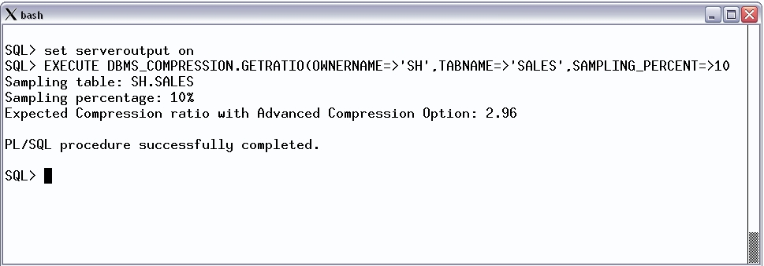
Consejero compresión tabla Estima ahoro de almacenamiento
Disponible en 12c
Disponible en OTN *
Soporta Oracle Database 9i Release 2
Muestra compresión de ratio para tablas no comprimidas
Notes:
59
Lets first talk about compression of regular relational data. We were the early pioneer in terms of compression technology for databases when we introduced table compression for bulk load operations in Oracle9i. Using this feature, customers can compress data at the time of doing bulk load using operations such as DIRECTLOAD, CTAS, etc. However, until now, compression was not available for regular data manipulation operations such as INSERT, UPDATE and DELETES. In Oracle database 11g, we have extended the compression technology to support these operations as well. Consequently, compression in Oracle Database 11g can be used for all kinds of workload – be it OLTP or DW.
It is important to mention here is that table compression enhancements introduced Oracle database 11g are not just incremental changes. Rather enormous amount of work has gone into making sure that the new compression technology has negligible impact on updates since any noticeable write time penalty due to compression won’t be acceptable in OLTP environment. As a result compression technology in Oracle database 11g is very efficient which could reduce the space consumption up to 2 to 3 times. And while you do that, not only your write performance does not degrade, your read performance or queries actually improves. This is because unlike desktop based compression techniques where you have to wait for data to uncompressed, our technology reads the compressed data directly and does not require any uncompression. This make sure that our query performance does not degrade because of compression. Now, the question is how does the query performance improve. It does so because we need to fetch less data to answer a query due to compression. Another advantage of fetching less data to satisfy a query is that we can now use the memory used to buffer the data read from disk more efficient thereby maximizing the memory utilization efficiency.
Finally, just to make sure that I do not miss any thing obvious, our compression technology is completely application transparent. That mean that you can use this technology with any home grown or packaged application such as SAP, Siebel , EBS, etc.

Slide 60
Conclusions
MultiTenant + JSON + InMemory + ACO

Slide 61
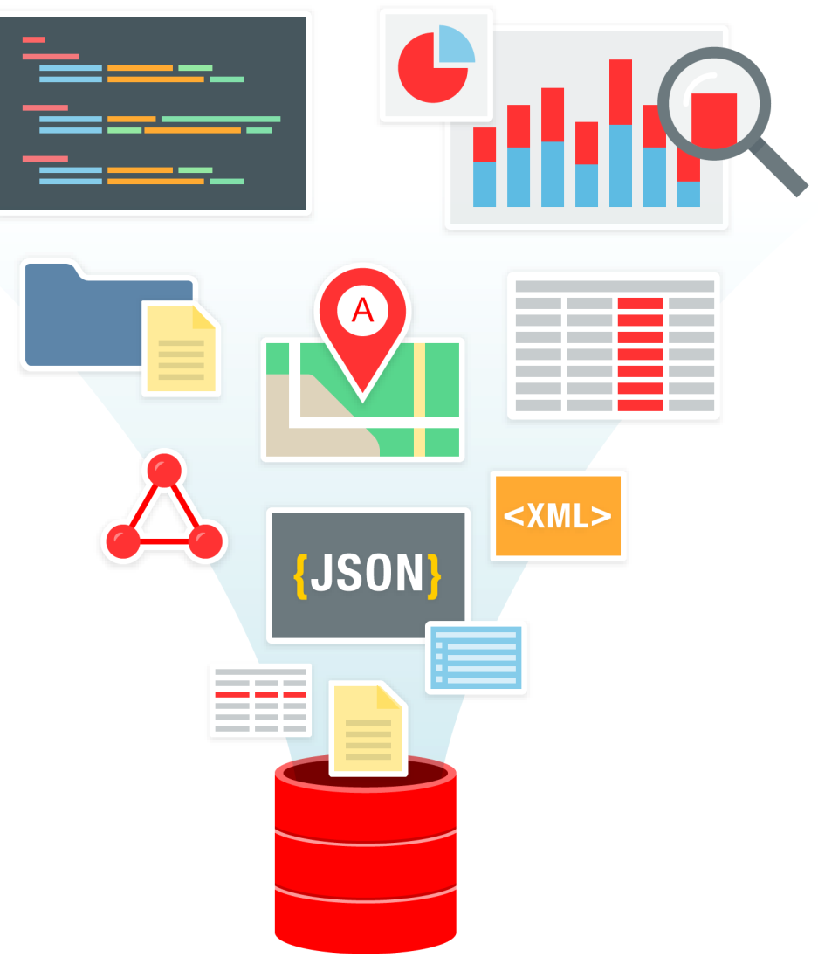
Oracle Database: A multi-model platform
Oracle Database supports multi-model persistence
Relational
XML
JSON
Text
Graph & Spatial
Oracle Database provides integrated access to all database objects
Notes:
The use of multiple single-model or multi-model databases depends on what the customer wants to do. Oracle offers the freedom of choosing either, multi-model or single model.
However, Oracle is also providing integration with single-model systems via Big Data SQL which is a key differentiator when choosing Oracle.

Slide 62
Strategy: Oracle Database as a Document Store
Built on Foundation of Oracle Database
Transactions and consistency
Advanced SQL engine
Enterprise-Grade High Availability
Enterprise-Grade Security
Scalability and Performance: Exadata and Real Application Clusters
Oracle Public Cloud Infrastructure
Sharding

Slide 63


Transactions and consistency
ACID transactions by default
Transactions across multiple documents and multiple collections
No hand-coding of two-phase commit required
Read consistency by default
Unique multi-version read consistency model ensures that read queries and updates queries run simultaneously, without blocking and with consistent results
Report
Update
update
Update
update
Accurate Results

Slide 64





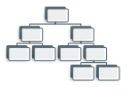





Advanced SQL Engine
Full-featured Query Processing Engine
PROFIT
SQL
SQL
SQL
SQL
SQL
SQL
SQL
SQL
UMSATZ
SALES
SQL
SQL
SQL
SQL
SQL
SQL
SQL
SQL
CAPITAL
SQL
SQL
SQL
SQL
SQL
RENDITO
Comprehensive SQL Language
Sophisticated query optimization
Joins, aggregations, filters, indexes, query transformations
Smart processing
Parallel, In-memory
Any Answer
Operational, reporting, analytical, predictive
Any data: Structured, Semi-structured
Notes:
Basically, this slide needs to highlight: query optimizer, breadht of query processing techniques (joins, aggregations, indexes, mv's), parallel execution and in-memory.

Slide 65

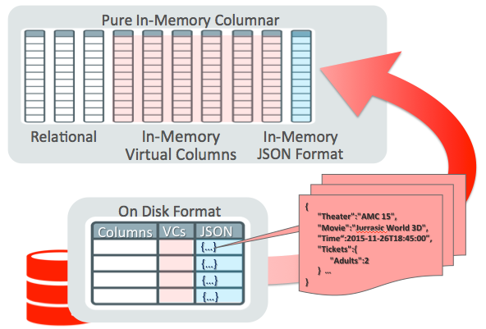
Query Optimizations for JSON
Exadata Smart Scans
Exadata Smart Scans execute portions of SQL queries on Exadata storage cells
JSON query operations ‘pushed down’ to Exadata storage cells
Massively parallel processing of JSON documents
In-Memory Columnar Store
Virtual columns, included those generated using JSON Data Guide loaded into In-Memory Virtual Columns
JSON documents loaded using a highly optimized In-Memory binary format (OSON)
Query operations on JSON content automatically directed to In-Memory

Slide 66
Workshop
MultiTenant + JSON + InMemory + ACO

Slide 67

Converged Database Workshop Series Marketing Campaign on going
Oracle Converged Database: Multitenant, Multimodel, In-Memory
For DBAs, Solutions Architects and Developers, including CTOs
One day in Torre Picasso or
Remote Zoom sessions (3 consecutive days, 2 hours each)
Oracle Converged Database: Multicloud ECX with Autonomous DB
For Data Engineers and Cloud Solutions Architects
One morning in Torre Picasso or
Remote Zoom sessions (3 consecutive days, 3 hours each)
Oracle Converged Database: Spatial, Graph & ML with Python and R
For Data Engineers, Data Scientists, Business Analysts and Solutions Architects
One day in Torre Picasso or
Remote Zoom sessions (3 consecutive days, 2 hours each)
Notes:
El primer Workshop es sobre arquitectura Multitenant con varios HOLs sobre configuración, administración y gestión de PDBs, JSON y mejora de Rendimiento. En el segundo se enseñan las tecnologías individualmente en HOLs con un caso de uso unificado al final que representa un caso real de extensión de un modelo transaccional llevado a analítico en tiempo real. El último es un ATPlab con varios HOLs sobre arquitectura multicloud alrededor de ATP accediendo desde OCI, AWS y GCP a través de Equinix ECX.

Slide 68
https://github.com/OracleDataManagementSpain/ConvergedDatabase
9 febrero
WORKSHOP_Multitenant_Multimodel_InMemory_HOL_v3_part1of3.pdf
10 febrero
WORKSHOP_Multitenant_Multimodel_InMemory_HOL_v3_part2of3.pdf
11 febrero
WORKSHOP_Multitenant_Multimodel_InMemory_HOL_v3_part3of3.pdf

